Slide 1
Detection Of Plant Disease Using Image Processing and Neural Network
Team Members Supervised by
1.Raju Yadav Dr . Ehemad Khan
2.Yong Guo
3. NaiQing Zhen
4. ChanPiseth Chea

Slide 2
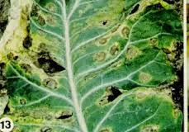
Introduction
Nearly 60% of the crops are being destroyed due to different diseases.
The detection of the plant disease based on IT in this technology era is challenging.
Detection of plant disease can be achieved using Image processing and Back propagation Neural Network.
early scorch->

Slide 3
Problem Statement
Most of the Crops are being Destroyed due to the different diseases.
Ultimately Loss to Farmer and country.

Slide 4
Objective
To detect the plant disease based on Image processing and Neural Network With Processing of symptoms(Text) .

Slide 5
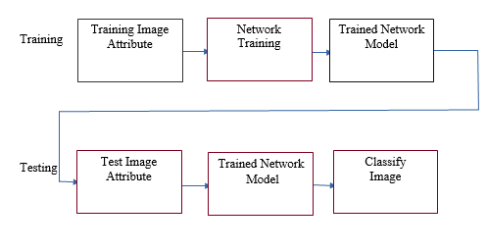
Conceptual model

Slide 6
Methodology
Image acquisition and preprocessing
Feature Extraction→Binning Pixels into 8 Attribute bins
K-means Clustering.
Training and feeding BPN
Classification Based on Classifier(BPN)

Slide 7
Table: Binning Pixels into Attribute Bins(Feature Extraction) Image is composed of numbers of pixels. Each pixel can be represented as the intensity of Red, Green and Blue (R, G, B).
Red Low | Red High | Green Low | Green High | Blue Low | Blue High | Attribute Bins
0 | 127 | 0 | 127 | 0 | 127 | 1
0 | 127 | 0 | 127 | 127 | 255 | 2
0 | 127 | 127 | 255 | 0 | 127 | 3
0 | 127 | 127 | 255 | 127 | 255 | 4
127 | 255 | 0 | 127 | 0 | 127 | 5
127 | 255 | 0 | 127 | 127 | 255 | 6
127 | 255 | 127 | 255 | 0 | 127 | 7
127 | 255 | 127 | 255 | 127 | 255 | 8

Slide 8
Example
Pixel1(R, G, B) → Bin(24, 240, 55) → Bin(0, 1, 0) → Bin(3)
Pixel2(R, G, B) → Bin(44, 240, 210) → Bin(0, 1, 1) → Bin(4)
Pixel3(R, G, B) → Bin(240, 232, 55) → Bin(1, 1, 0) → Bin(7)

Slide 9
K-means cluster
k-means clustering is a method of vector quantization, originally from signal processing, that is popular for cluster analysis in data mining. k-means clustering aims to partition n observations into k clusters in which each observation belongs to the cluster with the nearest mean, serving as a prototype of the cluster. This results in a partitioning of the data space into Voronoi cells.

Slide 10
K-means cluster

Slide 11
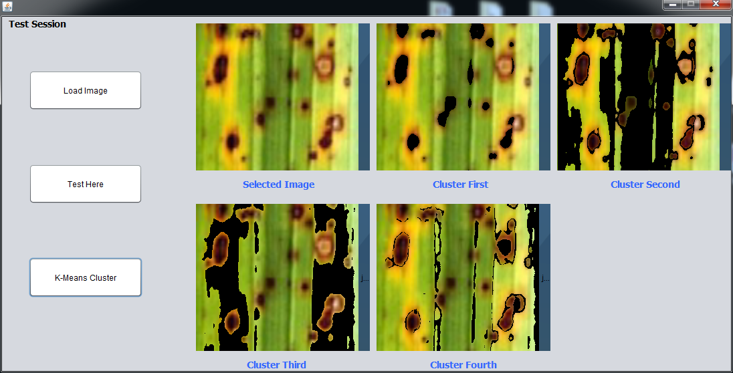
K-means output of our project

Slide 12
Back Propagation
The backward propagation of errors or backpropagation, is a common method of training artificial neural networks and used in conjunction with an optimization method such as gradient descent. The algorithm repeats a two phase cycle, propagation and weight update.

Slide 13
Back Propagation

Slide 14
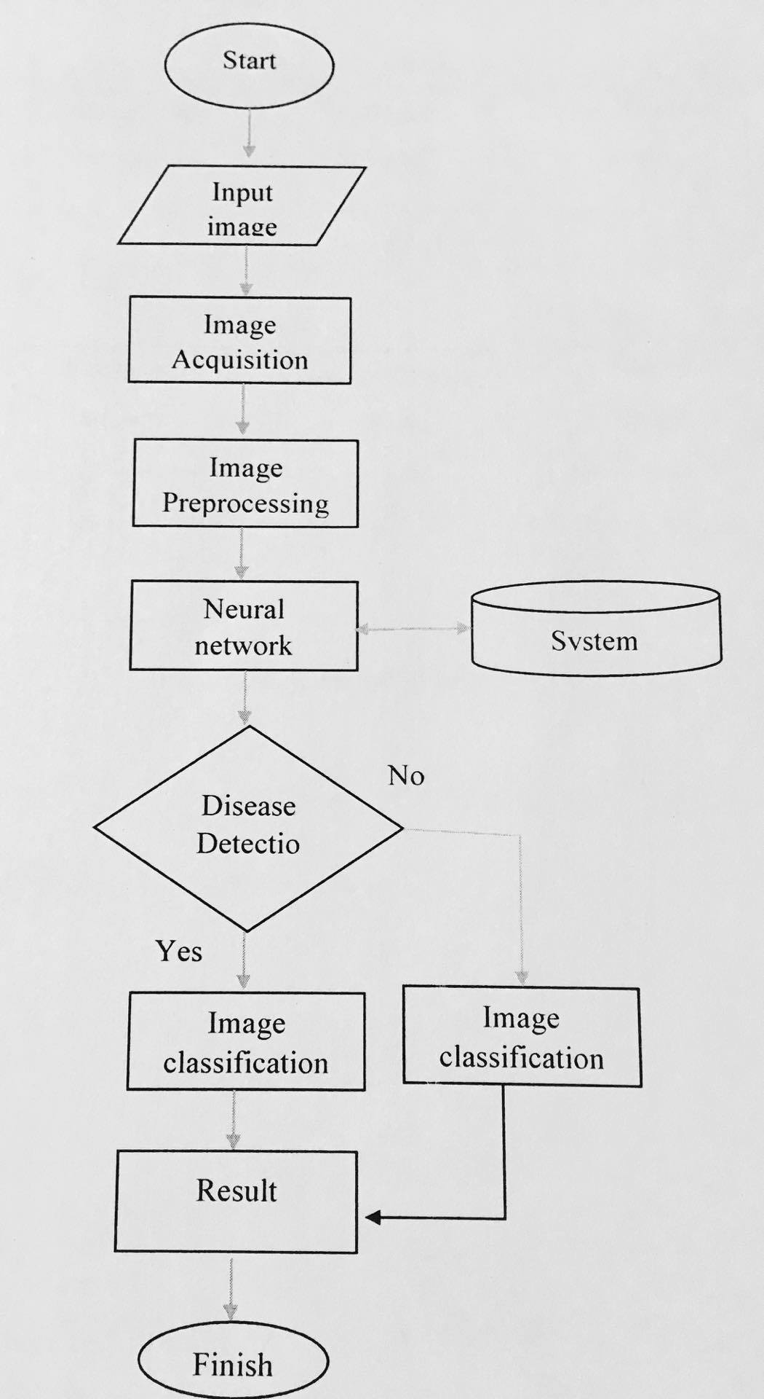
Flowchart

Slide 15
Work-Output
1. Image Preprocessing
2. Binning image pixels to 8 attribute bins
3. Feature Extraction
4. Training of BPN
5 Testing

Slide 16
Thank you

